Slide 1
System and Network Administration
Core Services:
DNS and DHCP

Slide 2
Configuring for Network Services
Networks are made of
Hosts that act as clients and servers
Servers share resources with AUTHORISED Clients
Media and Equipment that interconnect hosts
Protocols that govern connections
Users
Networks allow cooperation
Cooperation leads to communities of users

Slide 3
Names, Addresses, Routes
Hosts and their services need an identity
These definitions are inevitably mentioned:
o a name identifies what you want, and is generally a text string for human interpretation;
o an address identifies where it is, and is generally in a machine readable form;
o a route identifies a way to get there, generally as a list of names or addresses.
Administrators maintain these

Slide 4
Dynamic Allocation
At boot, the system knows its MAC address
What is the IP address? Netmask?
What is the route to other hosts?
Static Allocation – host configuration file
ifconfig
route add default gw
Dynamic Allocation – configuration server
need a request/reply protocol
need a server listening on a TCP/UDP port
Notes:
Network Admin - Network Components
12/08/2020
(c) Monash University
4
Host ID usually static – good for inventory
Install names are more descriptive names
More important for server hosts, not client hosts
“Physical level” addresses but not at the Physical Layer of the OSI or TCP/IP model
The MAC address is more correctly associated with the data link layer
Internetwork => Many networks => uniqueness crucial
Unique IP address from among hosts in multiple networks
Transport layer port numbering for identifying server processes
DNS and WINS for more descriptive but unique names
FQDN in Internets using DNS
NetBIOS names using WINS
Names must resolve to numerical IP addresses

Slide 5
Static Vs. Dynamic Addressing
Many networks use a combination of static and dynamic addressing.
Static addresses for servers, routers, and network management systems.
Dynamic addresses for end systems, including workstations and IP phones.
The number of end systems
30+ use dynamic
The importance of tracking addresses
Static provides a consistent audit trail

Slide 6




Slide 7
Dynamic Host Configuration Protocol (DHCP)
Centralized administration, superset of BootP
Servers allocate network layer addresses and save information about which addresses have been allocated.
All communication initiated by the client
Uses UDP on port 68 for client, port 67 for server
One DHCP session has a common xid ("transaction ID"), randomly selected by the client

Slide 8
Dynamic Addressing: DHCP
Server offers IP address and network parameters for a limited time (called a lease)
Addresses offered can be
Fixed addresses allocated to particular computers
From a pool of reusable IP addresses (supports hosts that are not online all the time - more hosts than addresses)
client can renew or relinquish the lease
address can be requested again when the lease expires
Lease renewal efforts occur at two intervals: 1/2 of the lease has been used and 7/8 of the lease has been used

Slide 9
Non-DHCP Client: static IP configuration
DHCP Client: IP configuration from DHCP server
IP Address1
IP Address2
DHCP Client: IP configuration from DHCP server
DHCP Database
DHCP Server
IP Address1
IP Address2
IP Address3

Slide 10
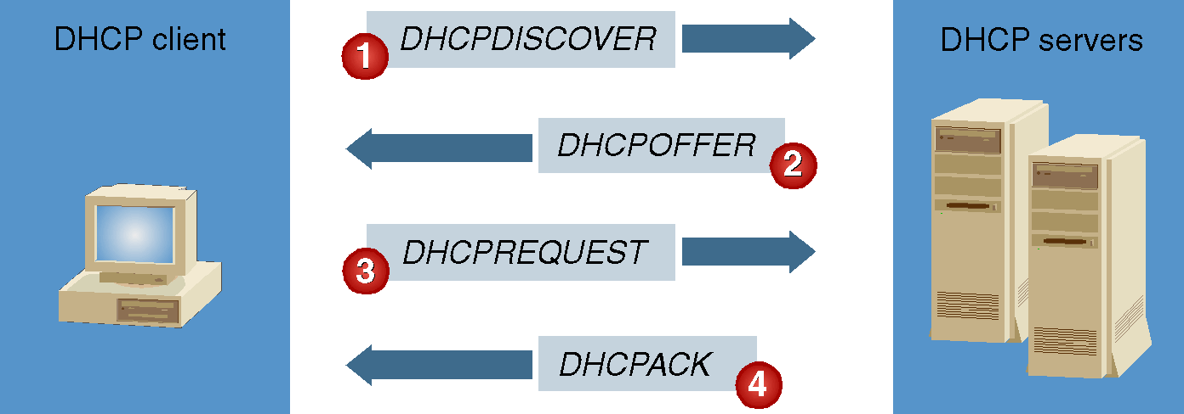
The DHCP Lease Process

Slide 11
DHCP: Messages
DHCP client broadcasts a DHCPDISCOVER message to its subnet (255.255.255.255)
A DHCP relay agent is configured to pass this request to DHCP servers not on the same physical subnet within the campus or enterprise
All DHCP servers that receive a DHCPDISCOVER request may send an DHCPOFFER
Contains an IP address and possibly other configuration information (subnet mask, DNS servers, default gateway, etc)
since a client typically does not need > 1 IP address, more messages needed

Slide 12
DHCP: Messages
DHCPREQUEST sent by client to request a certain IP address
Usually the one sent by an DHCPOFFER
also used to renew leases and to try to get same address after a reboot
message is broadcast since a client typically does not need more than one IP address but may get more than one DHCPOFFER
Response by server is DHCPAK or DHCPNAK
ACK: acknowledged, accepted
NACK: something is wrong (for example client requested an IP address it is not supposed to have)

Slide 13
DHCPREQUEST
Source IP Address = 192.168.0.77
Dest. IP Address = 192.168.0.108
Requested IP Address = 192.168.0.77
Hardware Address = 08004....
DHCPOFFER
Source IP Address = 192.168.0.108
Dest. IP Address = 192.168.0.77
Offered IP Address = 192.168.0.77
Client Hardware Address = 08004...
Subnet Mask = 255.255.255.0
Length of Lease = 8 days
Server Identifier = 192.168.0.108
DHCP Option: Router = 192.168.0.1
DHCP Client
DHCP Server

Slide 14
Using Option Classes
Vendor-defined Classes Manage DHCP Options Identified by Operating System Vendor Type
User-defined Classes Manage DHCP Options with Common Configuration Requirements
Client1
Configuration A
Client2
DHCP
Server
Configuration B
Client3
Configuration C

Slide 15
Commonly used dhcp options
option domain-name domain ;
Defines the domain part of the host name
option subnet-mask mask ;
Specifies the subnet mask in dotted decimal notation. If the subnet mask option is not provided, dhcpd uses the network mask from the subnet statement.
option broadcast-address address ;
Defines the broadcast address for the client's subnet.
option static-routes destination gateway [, gateway ... ] ;
Lists the static routes the client should use. The default route cannot be specified in this manner. Use the routers option for the default route.
option routers address [ , address ...] ;
Lists the routers the client should use, in order of preference.
option domain-name-servers address [ , address ...] ;
Lists the Domain Name System (DNS) name servers the client should use, in order of preference.

Slide 16
Unauthorised Server Trouble
Unauthorised DHCP server on your subnet giving DHCPOFFER to all requests
since most will send a REQUEST for the first OFFER they receive by default, may ignore OFFERs from enterprise DHCP relays
Unauthorised DNS server on your subnet giving response to all requests
may ignore the enterprise servers
extra/confusing traffic
USING SAME IP RANGE??

Slide 18
Names for Hosts
a name identifies what you want: a text string for human interpretation
an address identifies where it is: usually machine readable (numeric)
/etc/HOSTNAME defines the official name of the host (can see it in the command prompt)
/etc/hosts defines local static layer 3 addresses and aliases (localhost)
/proc/sys/net/ … records the interface names & addresses known to the kernel

Slide 19
Domain Name Service
The Internet DNS (Domain Name Service) provides translation between (binds) the IP address in numeric format and the user-oriented domain name
given a domain name a DNS server will return a numeric IP address;
given an IP address, the server may return a domain name (this service, known as a reverse-lookup, is actually optional).
Provides machine independent names (address can change while the name stays the same)
The DNS is only one example of network directory services; there are other naming, addressing, and directory systems in use.

Slide 20
Domain Name System
The DNS is a hierarchy of nameservers, each with local knowledge about the names and addresses in its zone of authority.
There is no global map of zones of authority. The DNS relies on the idea of delegation: transfer of authority for a domain beginning with root or “.” (dot) servers
example.org is a delegation from org.
Every server knows how to reach servers that are authoritative for names further down the hierarchy.
With a series of queries, a nameserver can follow referrals from servers with more general knowledge to find the server with the specific answer it needs.

Slide 21
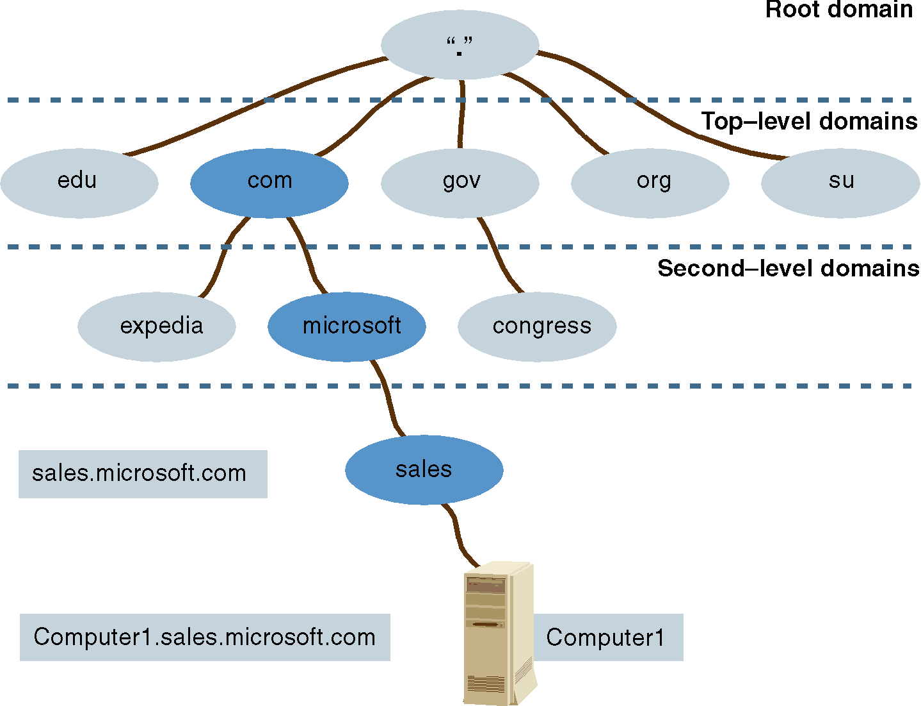
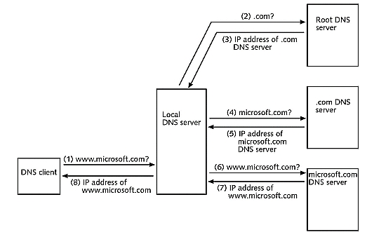

Slide 22
Delegation
Need to register with next highest level
all the way up to the root or “.”
these are known as Top-Level Domains (TLDs)
Identify organization and responsible persons
create pointers to authoritative server
[somebody needs to point to you!!]
A host name is the leftmost portion of the fully qualified domain name (FQDN), which describes the exact position of a host within the domain hierarchy.
DNS uses a host’s FQDN to resolve a name to an IP address.
Notes:
Network Admin - Configuration Management
12-Aug-20
(c) Monash University
22

Slide 23
DNS - /etc/services
Standard DNS traffic uses UDP port 53
if DNS requests don’t fit into a UDP response (typically 512 bytes) then it will try again using TCP;
A client computer will always send a DNS Query using UDP Protocol over Port 53. If a client computer does not get response from a DNS Server, it will re-transmit the query using the TCP after some interval.
By default, modern DNS servers use random ports above 1024 to query other nameservers. However, some firewalls expect all nameservers to communicate using only port 53.

Slide 25
Name Server software
Internet Software Consortium ISC makes reference implementations of DNS, DHCP
Available from http://www.isc.org/
Implemented by people directly involved with the standardisation process
standards compliant, very robust feature-rich implementations
Scalable: used for the global root nameservers
Notes:
Network Admin - Network Components
12/08/2020
(c) Monash University
25
Identities => the ability to distinctly identify and locate a resource.
Consider IP addresses and host names
Consider domain names
Consider protocols
Consider ports
Identities are crucial within the infrastructure

Slide 26
Name Server software
DNS on UNIX systems generally use Berkeley Internet Name Daemon (BIND) /usr/sbin/named
BIND usually runs as the process named (pronounced name d)
/etc/named.conf – sets general parameters and points to domain database (local files or remote servers)
/var/named/* – working directory for zone, statistic, and cache files
/var/named/named.ca – initial cache, points to the root domain servers
/etc/resolv.conf – client configuration, points to domain servers
/etc/host.conf – client configuration general parameters
Notes:
Network Admin - Configuration Management
12-Aug-20
(c) Monash University
26

Slide 27
Resource Record Types
Text name | Type | Function
Start of authority | SOA | Defines the zone and zone parameters
Name Server | NS | Identifies the nameserver for the domain
Address | A | Converts a hostname to an IPv4 address
Pointer | PTR | Converts an IPv4 address to a hostname
Canonical Name | CNAME | Defines another name (alias) for a host
Mail Exchanger | MX | Where to deliver mail for a domain
Text | TXT | Arbitrary text strings
Others types are defined, but not commonly used

Slide 28
TinyNet: DNSMASQ
syntax is different, but function is the same
integrated, simpler, suitable for small networks
preconfigured – isolated from enterprise services
auto-update (harder to do in ISC Bind/DHCP)
Has examples of everything we cover in this lecture

Slide 29
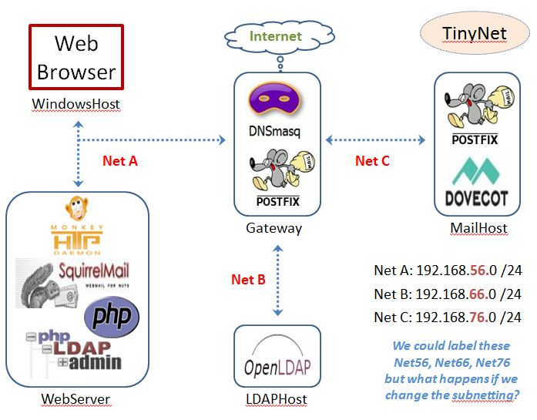
Gateway: One interface for each subnet
HOSTNAME
Is registered
With dnsmasq
Via DHCP
Matched to
Configured
cnames
Broadcast
Domain

Slide 30
Resource Records: A and CNAME
A (address record) specifies an IP address assigned to a name.
The A record binds a hostname to an IP address, while a CNAME record points another name to it (creates an alias): CNAMEs point to hostnames not IP addresses
/etc/dnsmasq/cnames

Slide 31
Resource Records: MX
MX (Mail eXchanger) tells where mail sent to a particular namespace in this zone should go.
The lowest preference-value is preferred; having multiple servers with the same value will distribute traffic evenly.
The email-server-name may be a hostname or FQDN.

Slide 32
Troubleshooting the DNS Service
nslookup and dig
Run in debug mode
Restart after updates
Check the logs to familiarise yourself with what it says when it starts
Ensure that the process is running,and listening on UDP (and TCP) port 53 (the domain port)
Requires skills of
Mechanic
Sociologist
Researcher

